Slide 1


Loan Approval Model
Xto10X Hackathon
Presented by:- Komal Yadav, Girish Kumar ,Komal Gupta

Slide 2
Problem Statement
In many real-world scenarios, having multiple candidate machine learning models allows data scientists to compare and choose the best performing approach for a given classification task. By splitting data into training and testing sets, different models can be trained, evaluated, and compared across various metrics like accuracy, R² score (even though it's typically more common in regression tasks, it can still be used in certain classification contexts), precision, recall, and F1-score. Furthermore, hyper-parameter tuning helps optimize each model's performance, ensuring that the final comparison is both fair and rigorous.
The goal of this project is to:
Divide the dataset into training and testing subsets.
Train at least five different classification models.
Record and compare their performances based on key evaluation metrics.
Perform hyper-parameter tuning for each model.
Build a dashboard that visualizes and compares the performance of these models.

Slide 3
Dataset Overview
Basic Information:
Objective: Predict whether a loan should be approved based on applicant data using Machine Learning models.
Dataset Name: Loan Approval Dataset
Source: Hackathon
Shape: 4269 rows and 13 columns
Key Columns:
Input Features: loan_id, self_employed , income_annum, loan_amount, loan_term , cibil_score, residential_assets_value etc.

Slide 4

EDA Insights

Slide 5
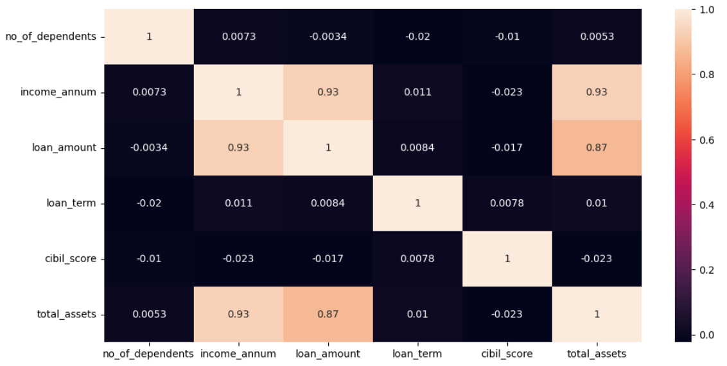
EDA(Correlation Matrix)

Slide 6
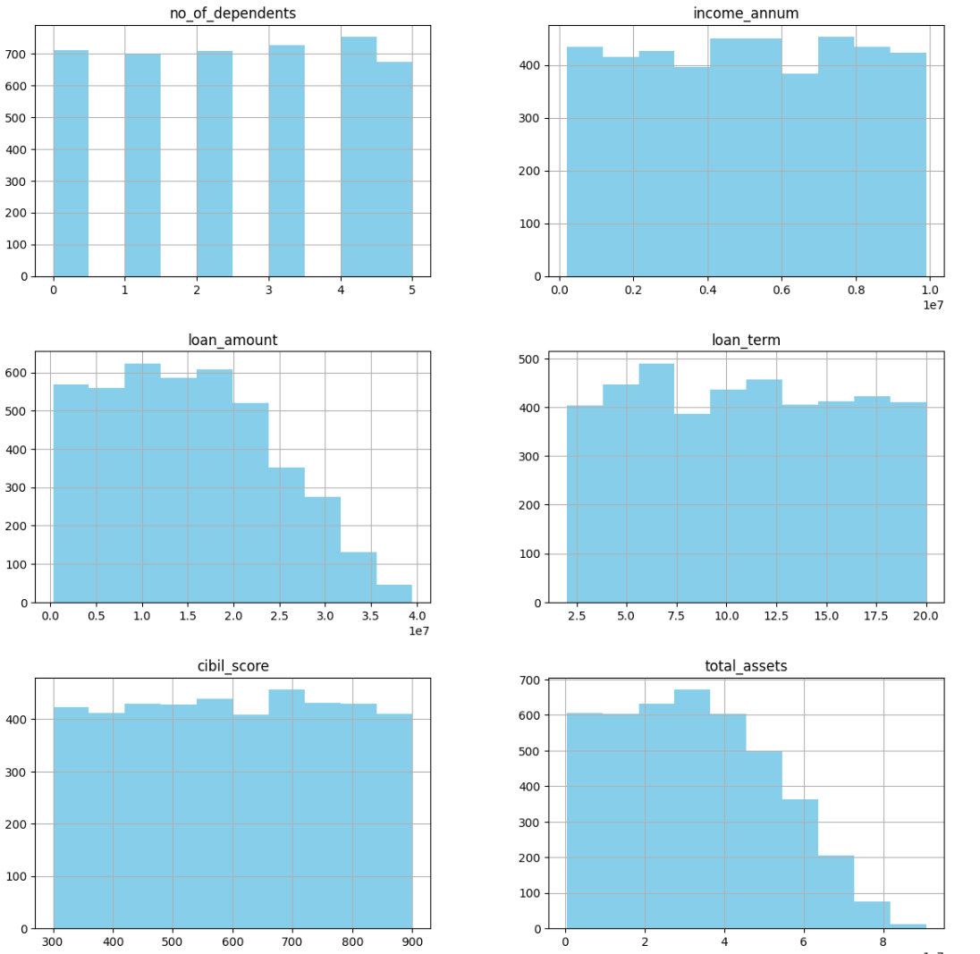
EDA(Histogram) )

Slide 7
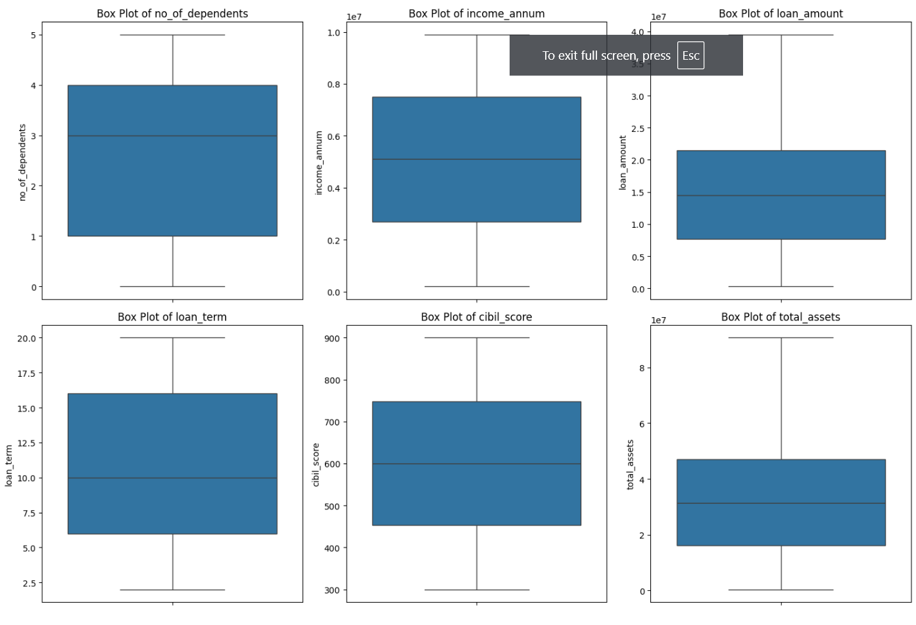
EDA

Slide 8
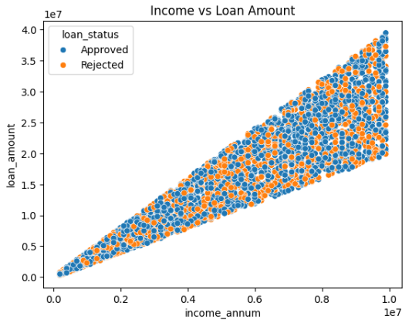
EDA

Slide 9
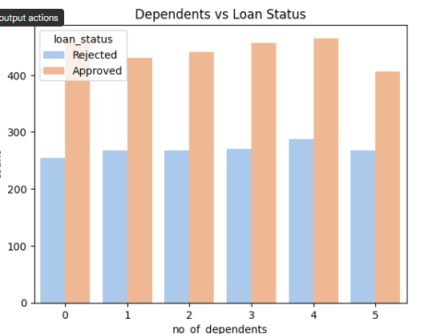
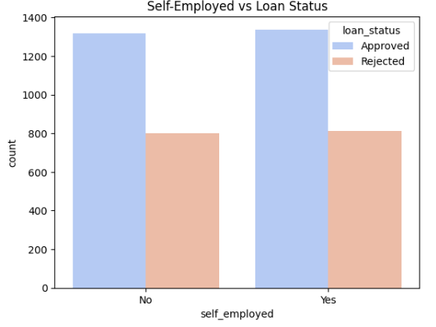
EDA

Slide 10
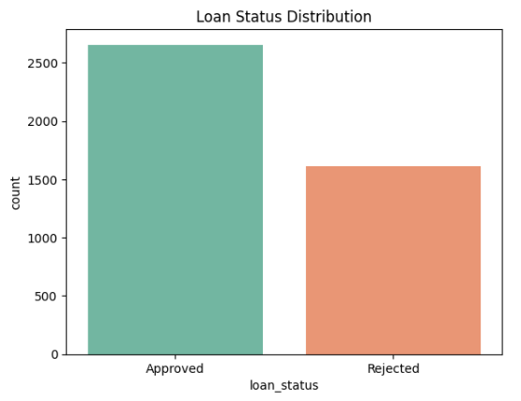
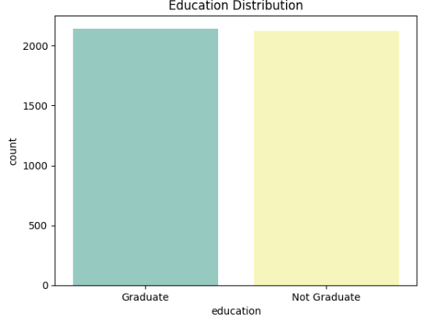
EDA

Slide 11
Model Selection
Algorithms Used:
Decision Tree
Gradient boosting
Random Forest
Support Vector Machine
Logistic Regression

Slide 12
Model Performance

Slide 13
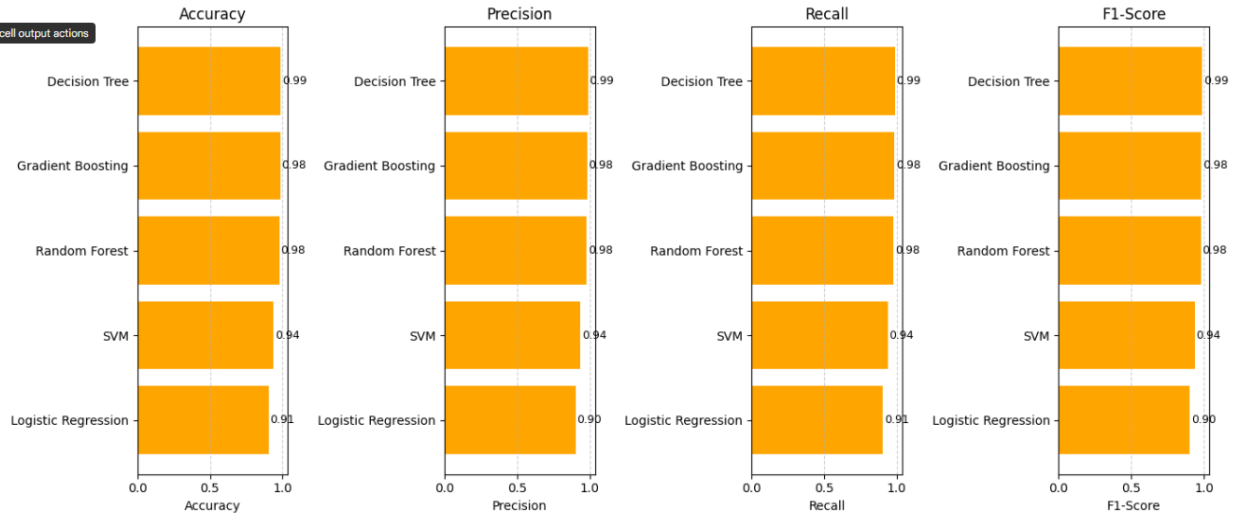
Model Performance
Model Performance(before Hyperparameter tuning)

Slide 14
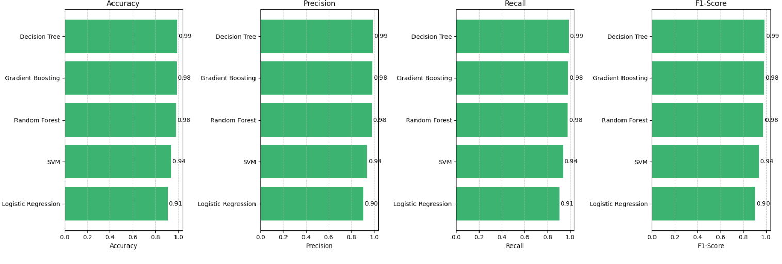
Model Performance
Model Performance(After Hyperparameter tuning)

Slide 15
Key Findings

Slide 16
Key Findings
Credit History has the highest impact on loan approval.
Married, Graduate, and Male applicants had slightly higher approval rates.
Income and loan amount play a key role in model predictions.

Slide 17
Recommendations

Slide 18

Recommendations
Prioritize applicants with a strong credit history.
Consider fine-tuning model thresholds for specific business risk levels.
Incorporate real-time financial checks to reduce false positives.

Slide 19
Conclusion

Slide 20
Conclusion of project
ML models effectively automate loan approval with decent accuracy.
Random Forest and XGBoost performed best.
Future scope: Add more features like location, employment sector, and real-time credit score API integration

Slide 21

Thanks
Do you have any questions?
For more contact :- 1)Girish Kumar 📧 girish119628@gmail.com 2)Komal Yadav
📧 ky4207479@gmail.com
3)Komal Gupta
📧 komalgupta4996@gmail.com

